Slide 1

Olist Store Analysis
By Group 3
Allam Sampath Kumar Ankit Kumar Sahu
Rohit Kunjilal Gupta Omkar Shashikant Chougule
Sumaiya Ummer Megha K
Shrutika Thorat

Slide 2

Brief Overview
Olist is a Brazilian e-commerce company that provides solutions for online sales and e-commerce services.
It offers a variety of technologies, tools, and connectors to help streamline and speed online business processes
Finally, provide remedies to the challenges and a benefit evaluation.

Slide 3
Objectives
Weekday Vs Weekend Payment Statistics
Number of Orders with review score 5 and payment type as credit card.
Average number of days taken for petshop
Average price and payment values from customers of Sao Paulo City
Relationship between shipping days Vs review scores.

Slide 4

Dataset

Slide 5
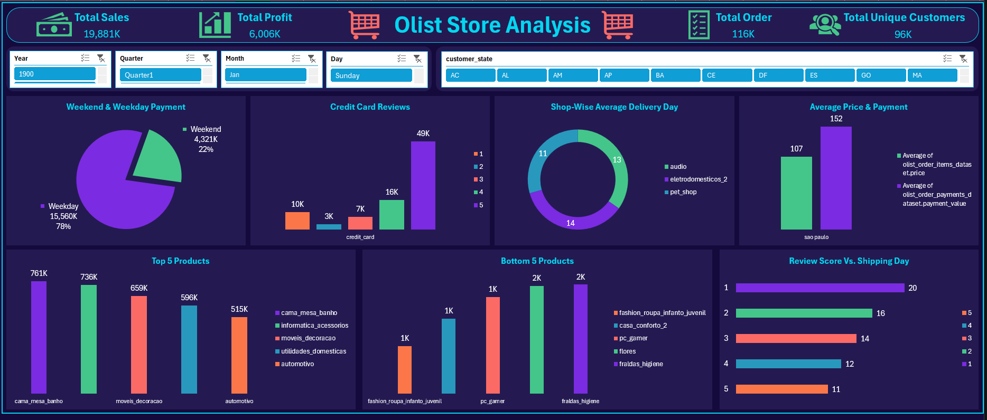
Excel Dashboard

Slide 6
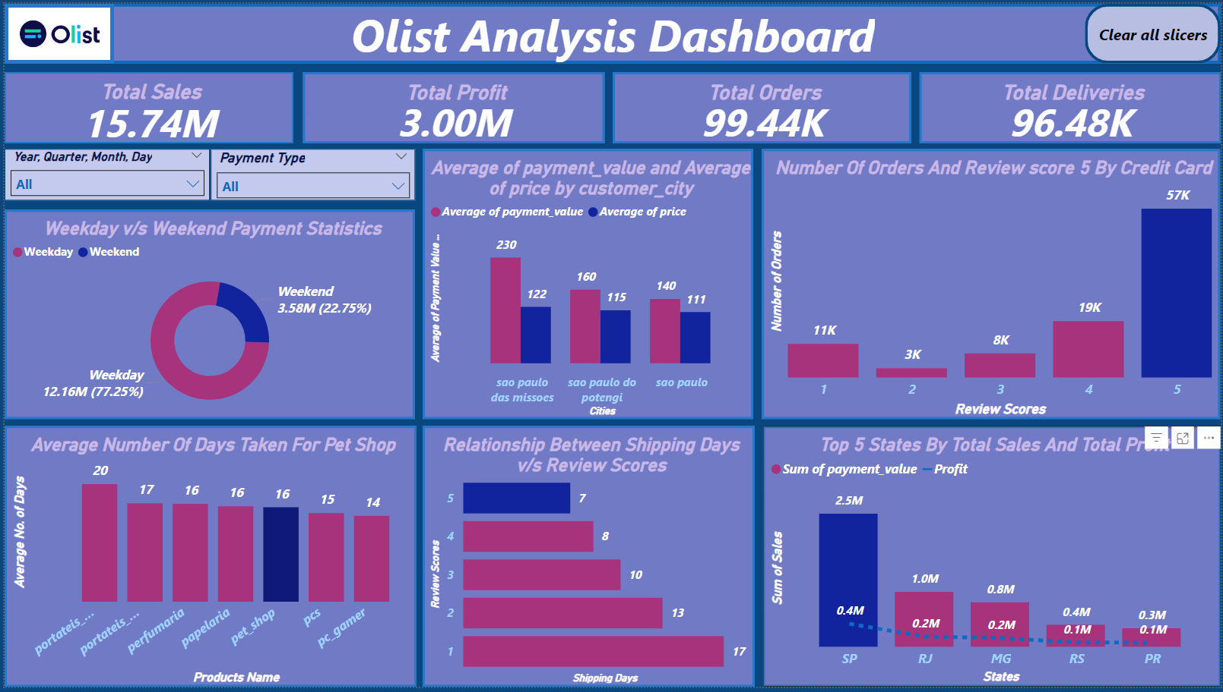
Power Bi Dashboard

Slide 7
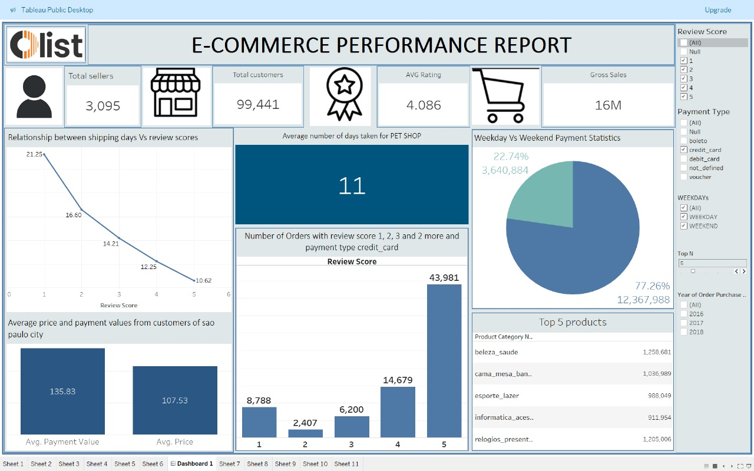
Tableau Dashboard

Slide 8
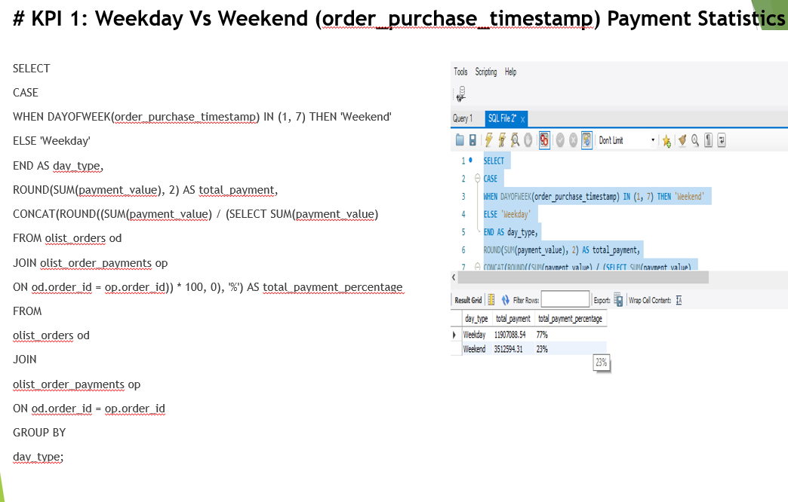
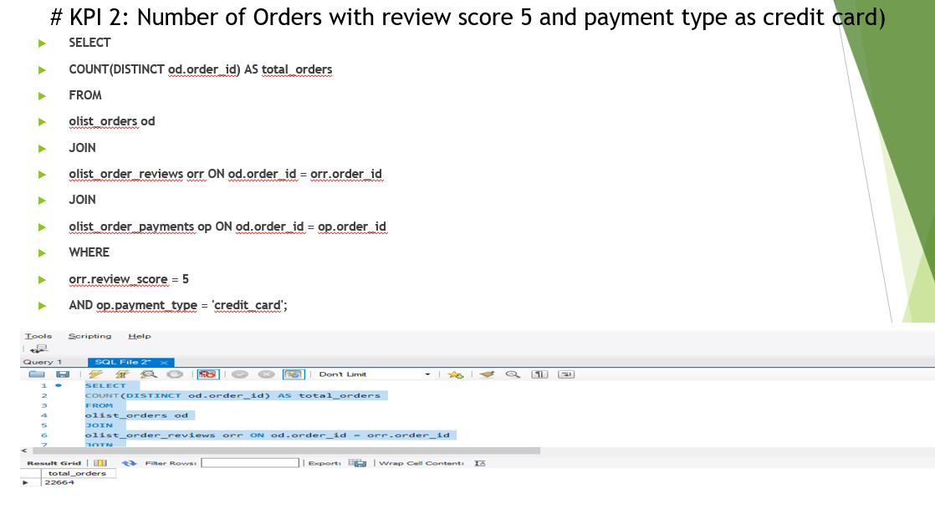
SQL Dashboard

Slide 9
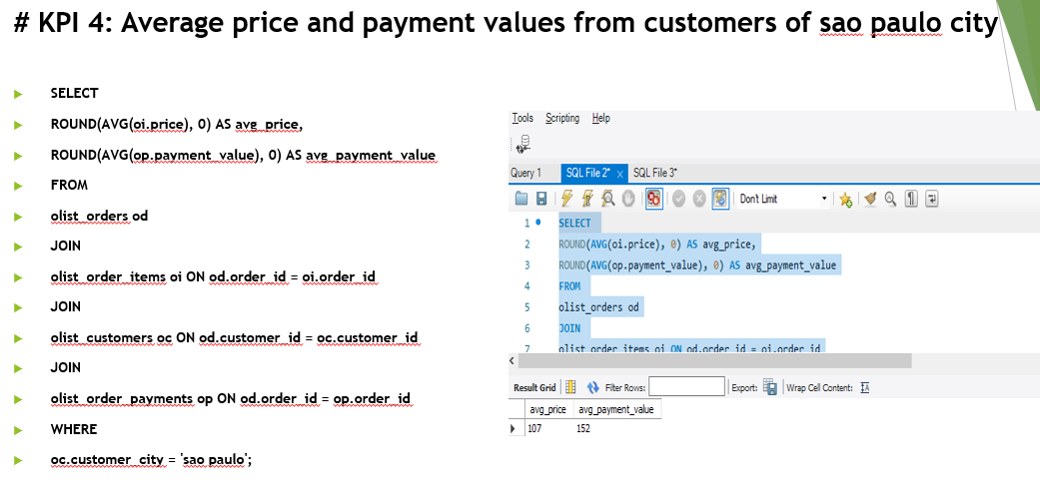
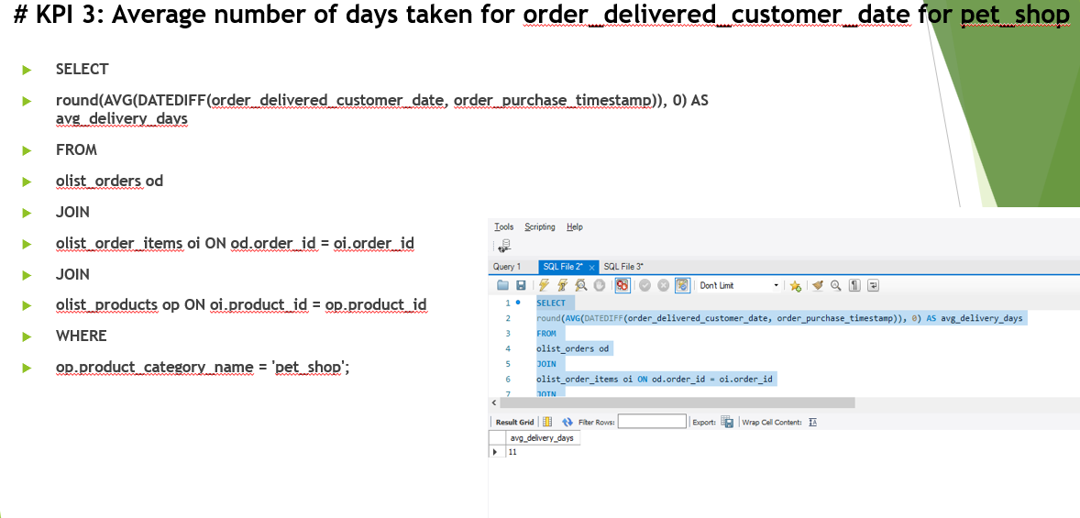
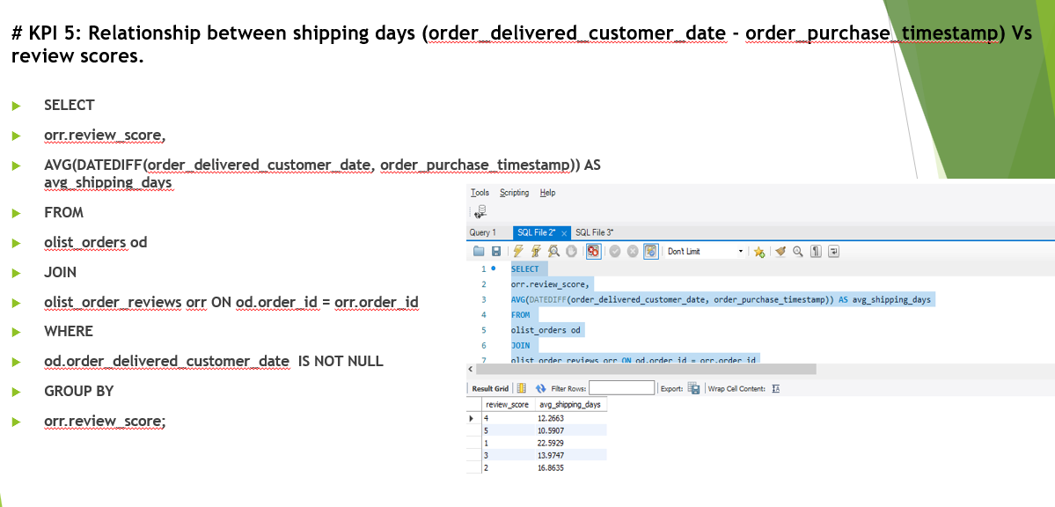
SQL Dashboard

Slide 10
Conclusion
We examined several facets of Olist’s operations in this analysis.
01
We found patterns and trends in everything from the population of products to consumer payments that can assist Olist in growing its revenue and business.
02
Olist is able to boost revenue more successfully and economically as a result.
03

Slide 11
Thank you

